Slide 1
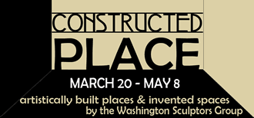
Artists’ Statements

Slide 2
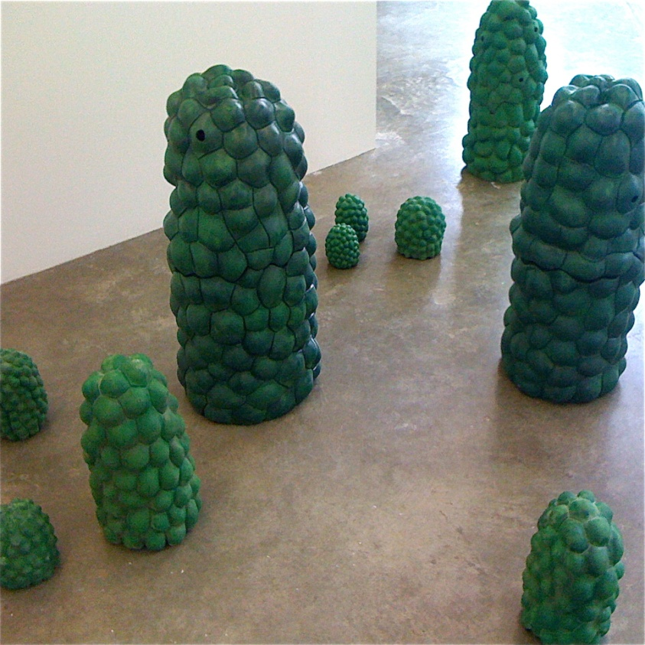
Sarah Allison
My studio work and research focus on ecological art. By combining living plants and their form with ceramics, I reflect human interactions and impact on nature. The habitat of a specific species and its biogeographic area, which support growth, influence me to create ceramic and live plant habitats for the urban environments encroaching on them.
Urbanization, habitat fragmentation, and habitat reduction due to water depletion and lack of biodiversity are topics I address through my installations. Through judiciously selecting material, and utilizing powerful environments, innovative designs, and practical demonstrations of active engagement, my aim is to storefront the aesthetic value of the work. I hope the work will also create an impression to shape and inspire social consciousness in others as a call to action.
Calla Lily Seed Pod, 2010
Ceramic

Slide 3
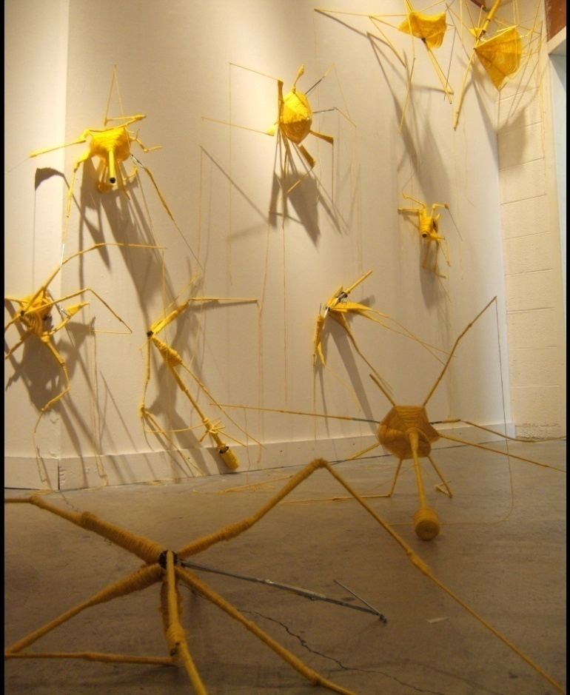
Jessica Braiterman
Both inside and outside of the studio, my process involves an engagement with my environment through observation, collection, distillation, and reimagining. My notes and found objects become markers in a shifting sea, an entanglement of flotsam which sustains, unravels, and transforms the work. I aim not for resolution. Instead I seek to find points of tension, the suspension of ordinary logic, perhaps even a hint of the infinite.
I often marvel at natural phenomena– clouds, the play of light in the forest, the motion of bird flocks. These impressions begin to bear weight of forms, growing slowly, carefully. For me, the process/work/labor is fundamental. I find myself becoming entrenched in laborious methods because I enjoy the slowness and because of a certain curiosity about a system and what it will do, how it will grow. Over time, these systems take over and I find myself just watching and listening as they shift, expand, and redirect.
Mutation, 2006
Broken umbrellas, yarn

Slide 4
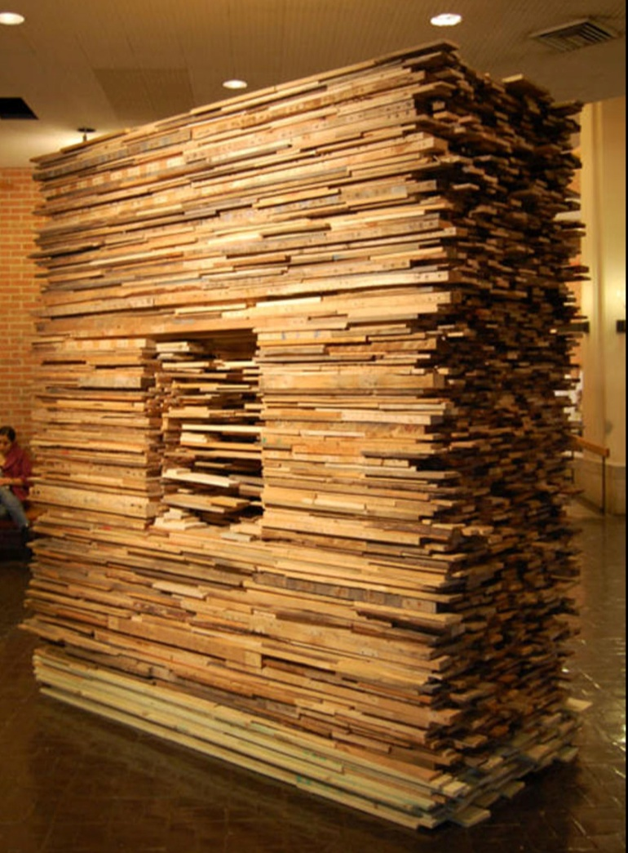
Anthony Comes
My art provides an opportunity to enhance the public’s creative thoughts and a means by which to exchange knowledge, skills, and techniques to influence society to appreciate a life.
As an artist, I employ sculpture to manipulate a physical interaction with and influence upon the viewer. Because of its three-dimensionality, sculpture has the unique and inherent ability to stimulate primordial emotions and latent knowledge. During the approach, my sculpture aims to wow the viewer twice by its presences and again with its finer details.
Reuse, Rethink, Recycle, 2009
Wood

Slide 5
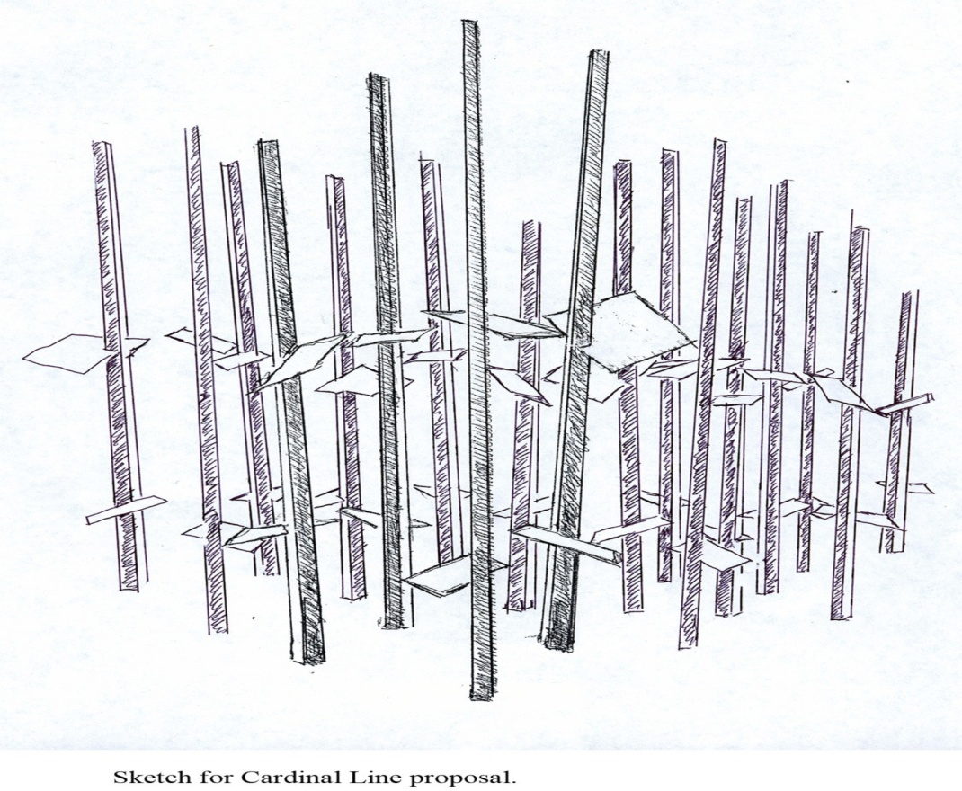
Bobby Donovan
My sculpture is created almost exclusively for out-door, natural environments. The forms I create reference nature’s forms. It is not my intention however to directly mimic nature; instead, I strive for an expression that initiates an engaging dialogue with the natural world– one that modestly accentuates some small measure of nature’s overwhelming beauty.
Cardinal, 2006
Wood, slate, rebar

Slide 6
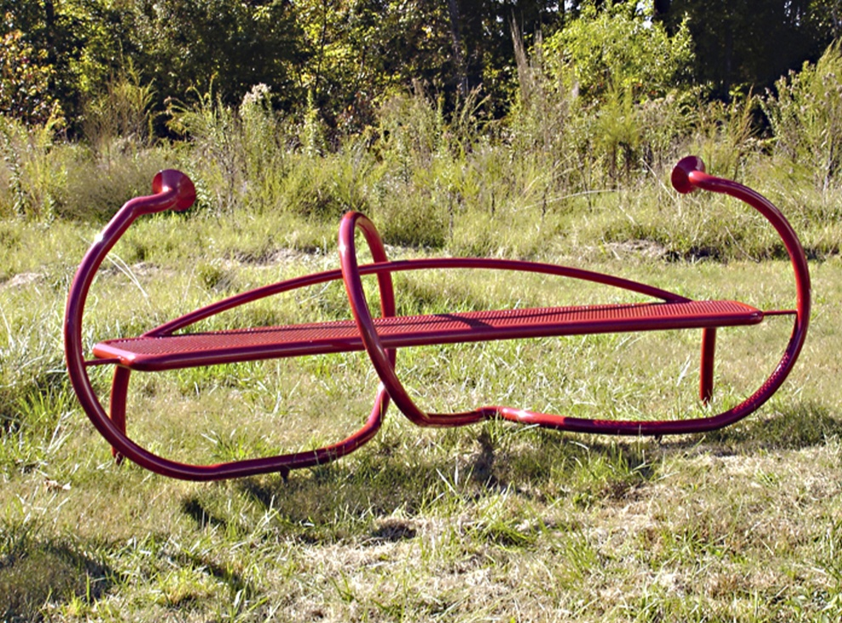
Jim Gallucci
My benches are playful objects that invite interaction with the passer-by. Though they function as seating, there is an impracticality of form that lures people to explore each bench and begin to discover what each is about. My benches are practical yet also tell the visitor a story by creating a sense of place and often inviting interaction with the bench itself. Several benches grouped together can create a signature area.
Whisper Benches, 2007
Powder-coated steel

Slide 7
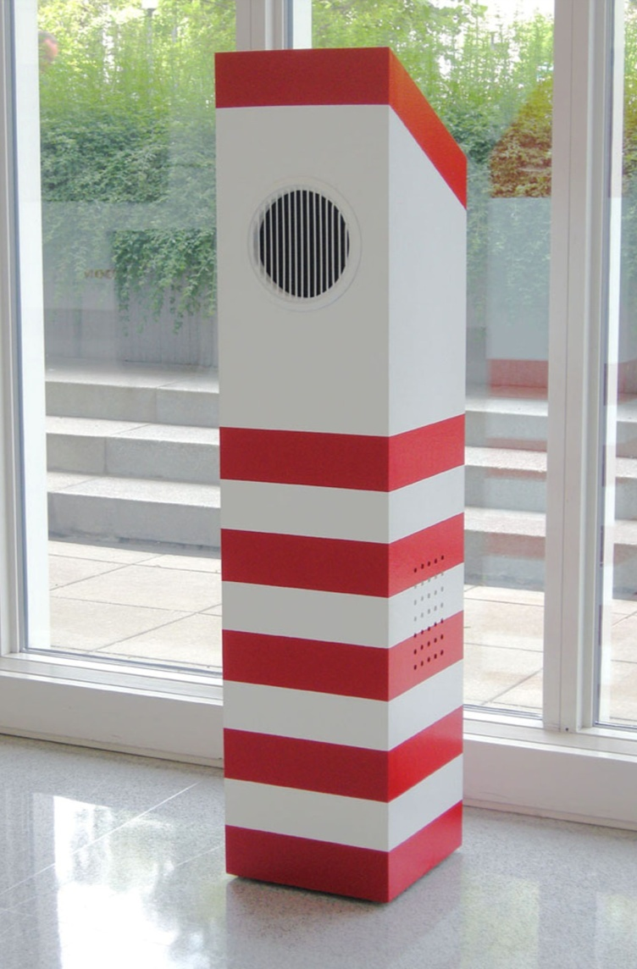
Tom Greaves
Throughout history, art has served as an expression of individual and social views of the world. In this current age of uncertainty, all views deserve consideration. By frequently experimenting with new materials and motifs and immersing myself in different environments, I hope to expose myself to as many of these views and ideas as possible. It has been said that art is the journey, not the destination. I want my art to seek, rather than to explain.
The Compliment Machine, 2007-2010
Audio, wood, enamel, steel

Slide 8
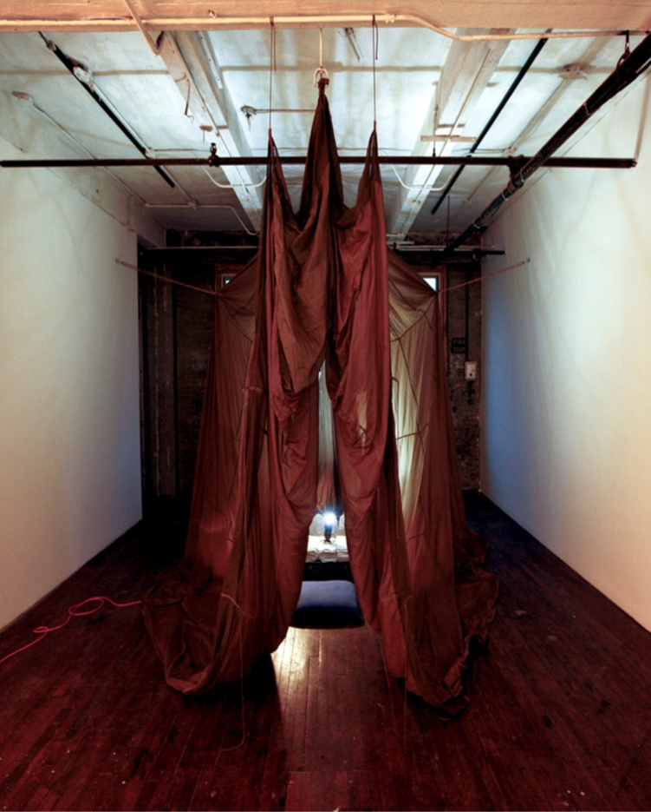
Meaghan Harrison
My work is built upon my interests in ceremony and ritual, human relations, economics, and consumer discord. The main theme in my work is that all these topics come together to reconnect us with the spiritual and ceremonial aspects missing in our lives. To accomplish this reconnection viewer participation is key to the work’s interpretation. The media I choose is dependent on what I want the work to communicate. The final result is an experiential installation that the viewer is allowed to explore and interact with. Currently my interests are strongly influenced by our contemporary ritual acts.
Trust, 2010
Performance, parachute, rope, electrical cord

Slide 9
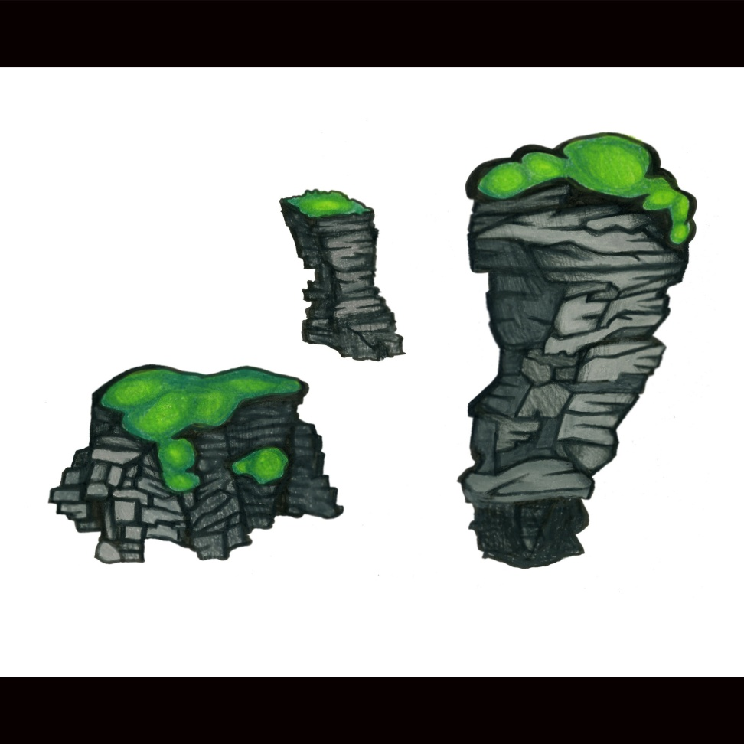
Matt Hollis
My work evokes a heightened reality where abstract-organic shapes and saturated colors stimulate the senses. With this enhanced awareness, the everyday becomes otherworldly. My installations aim to transform the environments they inhabit, engaging the viewer and activating all of the unseen possibility of the space.
Sea Stacks, 2010
Foam, silk plants, fabric

Slide 10
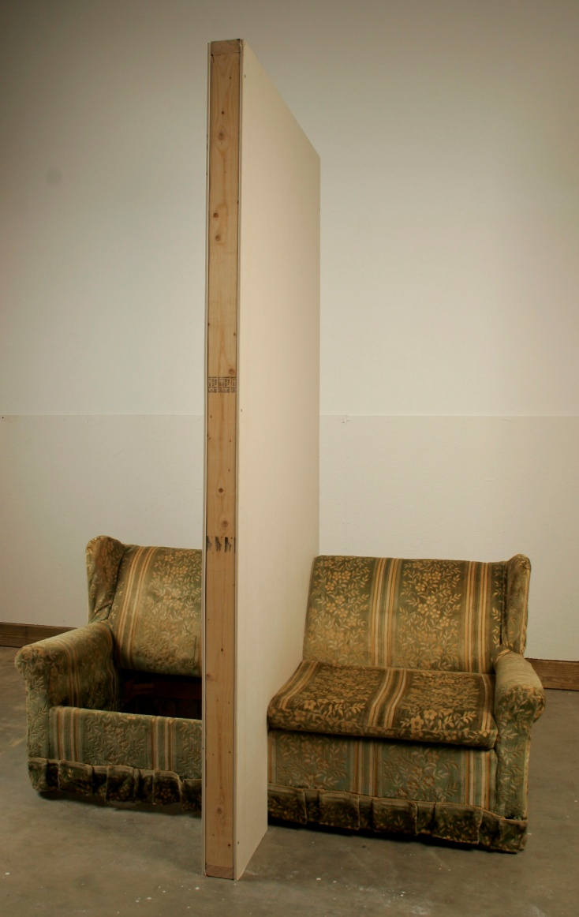
Ron Longsdorf
The philosophical questions surrounding existence in connection to personal relationships, spaces, places, and objects is a dialogue inherent in my work. My work questions the methods and actions of communication, interaction, and existence associated with domestic spaces and personal relationships. I personify inanimate objects to shift the context to the body, acting as a character, to create situations exploring mental and physical distance of personal relationships. It is important to use the past as a way of understanding the present and future, done so by recreating autobiographical experiences from the past into an abstraction of recognizable objects used in a situational way. My installations and sculptures use various combinations of altered domestic objects, home building materials, audio and/or video to create a situation for the viewer to experience, to generate a dialogue and question ourselves.
Further and Further Apart, 2009
Altered couch, wall studs, drywall,
electronics, audio

Slide 11
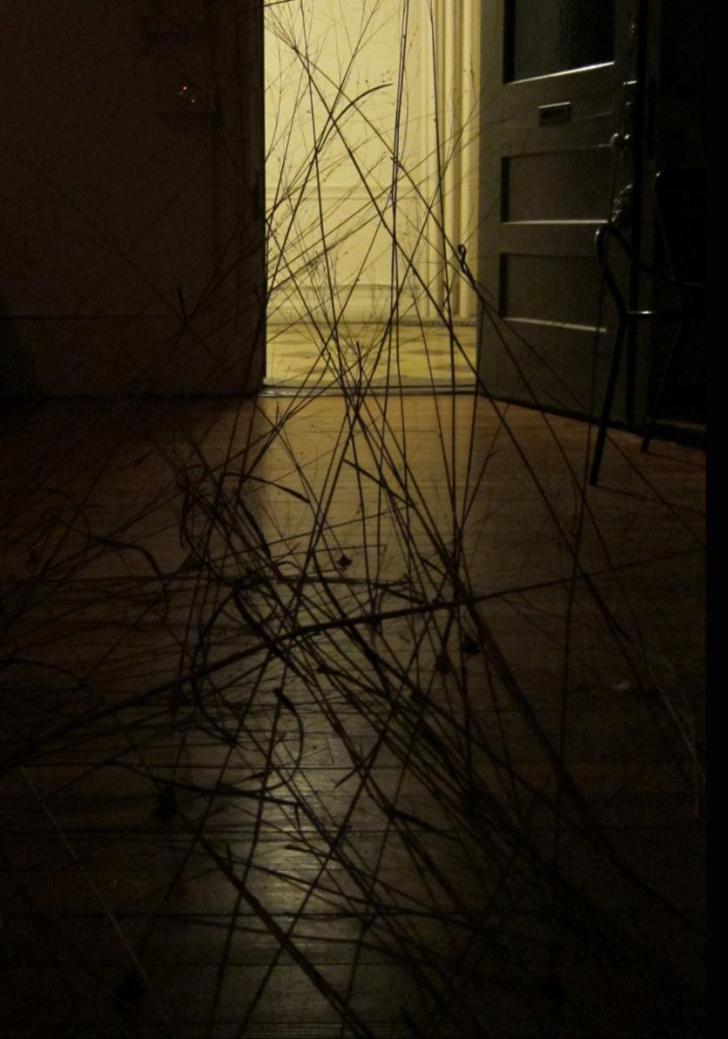
Christine Sciulli
My current body of work strives to create a dialogue between a projection and its transformation, challenging the perception of seemingly simple geometries.
By projecting moving lines of light onto large immersive “network” installations, I am seeking to re-composite what we think we know about light and space, while calling into play what content we each bring to bear on purely abstract, geometrically driven elements. The interception of roving lines of light generates a dynamic three-dimensional mapping of the straight line as it becomes unraveled and fluidly recast in space as a multitude of moving co-planar points of light.
Truro, 2010
Grass, Light

Slide 12
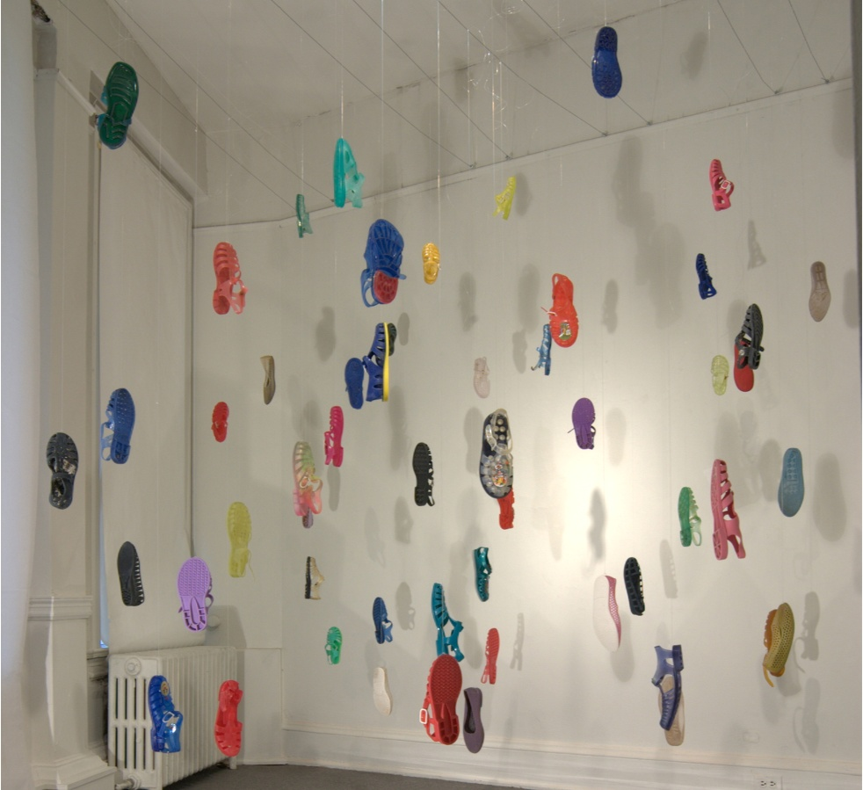
Patricia Segnan
In the collage process, I find imagery which intuitively strikes chords of memory. The recombination of objects creates a new context which transcends the individual objects themselves. This experimental game of construction can be playful, yet can carry emotional weight. The process of assembling these pieces often requires a lengthy period of gestation in which their new meaning can float to the surface of consciousness. These 80 colorful plastic shoes were dug from the sand over a period of years. Suspended from above they imply loss and ascendance, excess and environmental degradation, but also joy and whimsy.
Lost and Found, 2010
Found objects and filaments

Slide 13
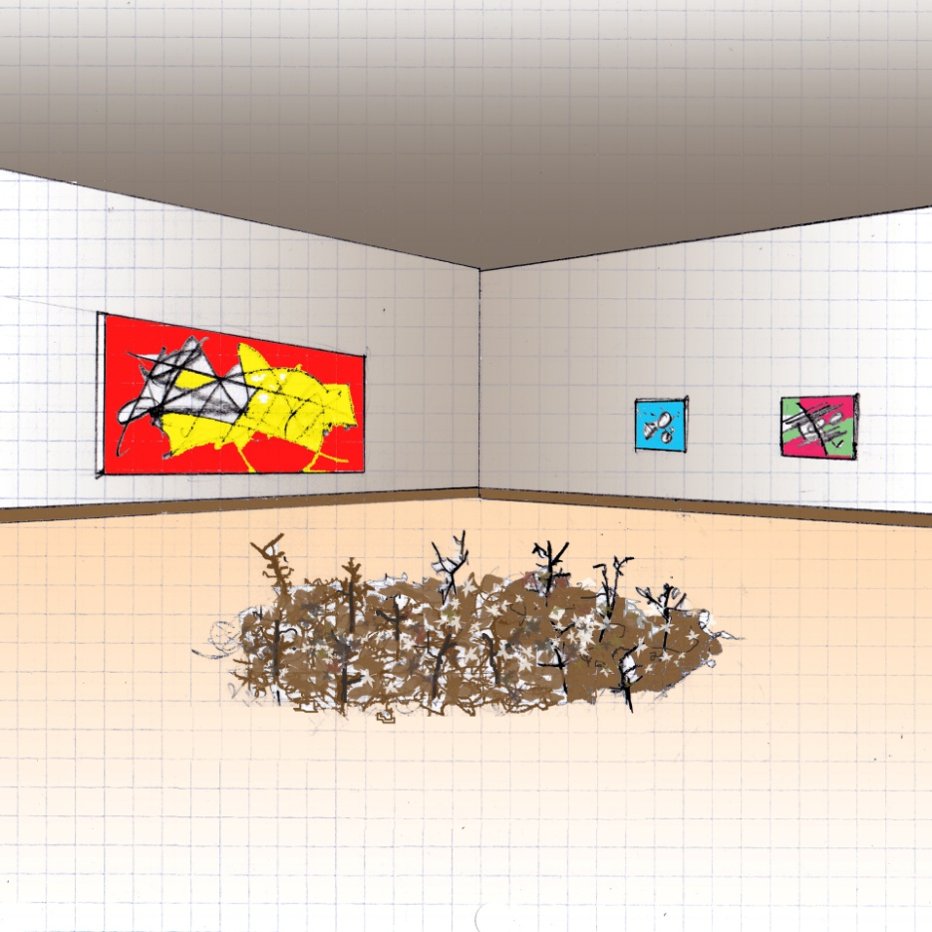
Mike Shaffer
Mysteriously quiet and serene, the deep forest floor can entice us to look at its stillness and listen to its silence. Only in time does its tranquility slowly give way to slight and subtle movements of its twigs and leaves at the urging of breezes, tiny creatures, or the purity of natural growth. This work is intended to call our attention to the nature of the forest floor– hushed and inanimate at first sight, but up close, turning and prodding our sense of wonderment.
Turning 16 on the Forest Floor, 2010
Small branches, dry leaves, clock motors

Slide 14
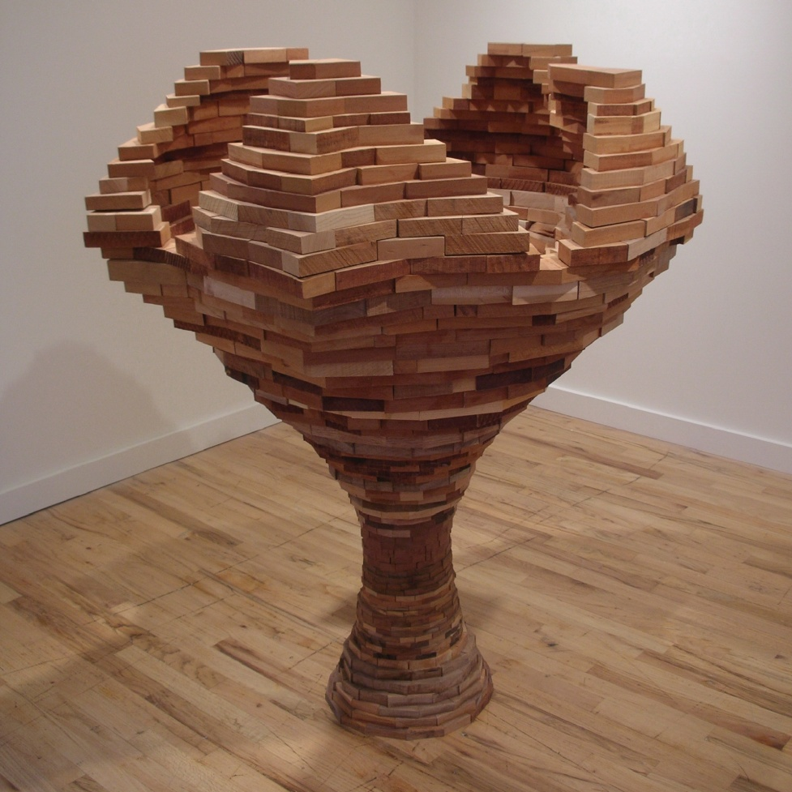
Foon Sham
I have used wood as a primary material in my sculptures for the last 25 years. I employed hundreds of wood blocks and tree materials of various sizes, stacked, layered, and joined with great attention to surface details. Some of my works are architectural and invite viewers’ participation by walking in and out, such as “Vessels on the Rise.” My installation works employ multiple elements to convey a theme that could be emotionally driven, such as “Sea of Hope,” or “Katrina,” while “Flow” dealt with immigration and interaction as landscape. My recent work involved discarded phone books as mixed media, both as identity issue as well as transformed texture and objects.
In-exterior, 2006
Mahogony and Cherry

Slide 15
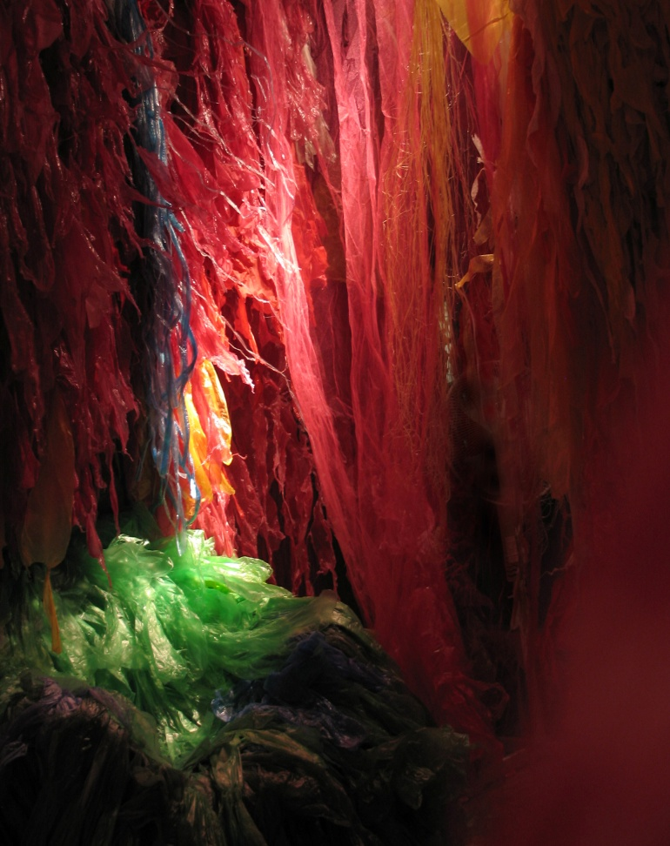
Al Zaruba
I build interactive wind-blown spaces that are visceral, explicit in their plastic nature, yet haunting, nuanced and deeply intimate in their implicit associations. My work has a spiritual intent resting in the silences rather than the substances, akin to social mirrors.
Within, 2009
Plastics, wood, light, wind

